Slide 1


Slide 2

WEB APPLICATION DEVELOPMENT PROJECT
PRESIDENT INSTITUTE OF COMPUTER APPLICATION
T.Y. B.C.A (2021-22)
“URBAN PAWS”
An online pet shop for animal lovers
Developed By: -
NAME | ENROLLMENT NO:
SUMEET GAUTAM GHOSH | 202012101773
KARAN SURESH HARWANI | 202012101780
DHRUV AJAY GHATGE | 202012101771
PRESIDENT INSTITUTE OF COMPUTER APPLICATION
AHMEDABAD
Affiliated by GUJRAT UNIVERSITY

Slide 3
COMPANY CERTIFICATE

Slide 4


To,
The Director
President Institute of Computer Applications Ghatlodiya,
Ahmedabad-380061
DATE:01/04/2023
TITLE:” URBAN PAWS” An online pet shop for animal lovers
With reference to your college letter, This is to inform that “Ghatge Dhruv Ajaykumar - 202012101771 of group member-1”, ”Harwani Karan Suresh – 202012101780 of group member – 2”, “Ghosh Sumeet Gautam – 202012101773 of group member – 3” students of President Institute of Computer Applications are selected for Project Training as a part of their Sem-VI syllabus.
Authorized Signature,
[Project Manager]
25, Shilpa Society D-cabin Sabarmati Ahmedabad Gujarat India – 380019
8320125619 | mailto:hello@tinosaur.in | https://www.tinosaur.in/

Slide 5
COLLEGE CERTIFICATE

Slide 7
Acknowledgement

Slide 8
Acknowledgement
First of all with profound pleasure and deep gratitude we thank “Mr. Varun Shihara” and Tinosaur administration for giving us good opportunity to explore this project. We are very much thankful to “Asst.Prof . ” for their valuable Guidance and useful suggestions during the span of this project. We are also thankful to “Mr Vasant Saraswat” for their mentorship and giving us guidance during the span of this project.We are also thankful for their suggestions for literature material and moral support during this period.S.D.P in charge “Asst. Prof. Dipam Rami ” and B.C.A Department and the whole staff of President Institute of Computer Application.

Slide 9
COMPANY PROFILE

Slide 10
COMPANY PROFILE
About Tinosaur
Tinosaur is a design agency in India for more than 4year consistent delivering business value with the latest technology.
Tinosaur is a privately owned venture of creative and customized products, IT Solutions, and IT Consultants formed 4 Years ago. We always aspire to create a resistant future. We believe in bringing Business, People, and Technology together in the way forward. Tinosaur is focused on rigorous development and comprehensive quality.
Tinosaur is dedicated towards perfection in every aspect. Professionalism is the main ingredient of Tinosaur. We strongly believe in delivering the best services to the clients till their satisfaction. Main objective of Tinosaur is to provide professional, qualitative, innovative and accessible services in every possible form.
Address:
25, Shilpa Society D-cabin Sabarmati Ahmedabad Gujarat India – 380019
8320125619 | mailto:hello@tinosaur.in | https://www.tinosaur.in/

Slide 11
INDEX
SR No | Title | Page no
1. | Validation | 12
2. | Admin Interface | 16
3. | Product Upload/Delete | 19
4. | User Interface | 22
5. | Reports | 27
6. | Conclusion | 30
7. | Bibliography | 31
8. | Log Sheets | 32

Slide 12
1.Validation

Slide 13
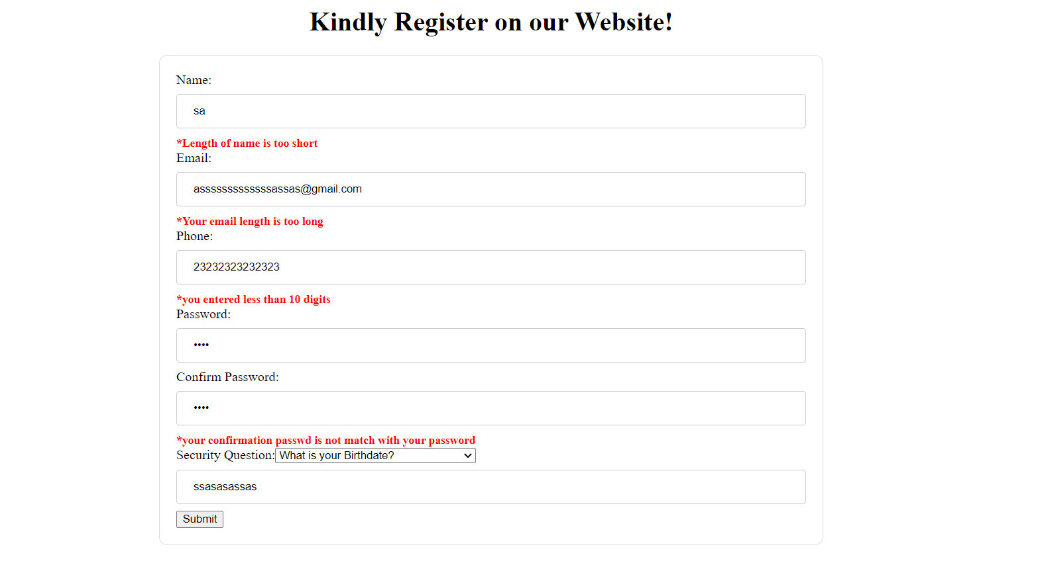
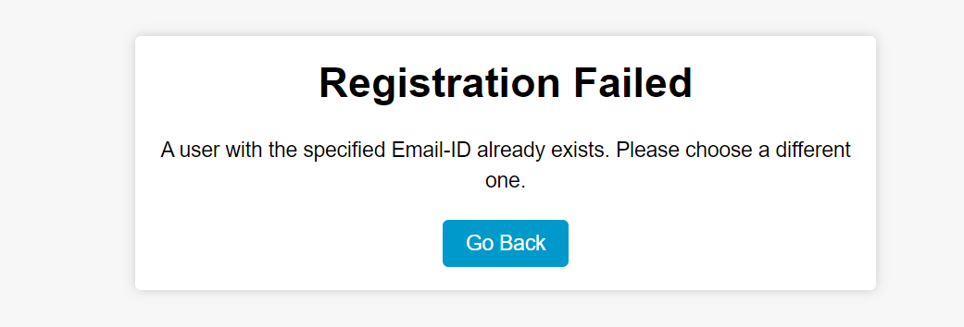
1.1 Registration
1.2 E-mail Already Exists :

Slide 14

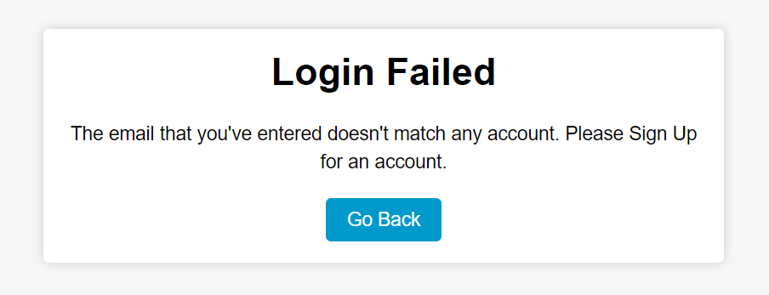
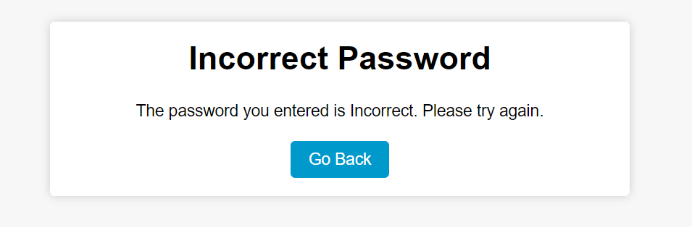
1.3 Login:
1.4 Email Doesn’t Exist:
1.5 Login Page:

Slide 15
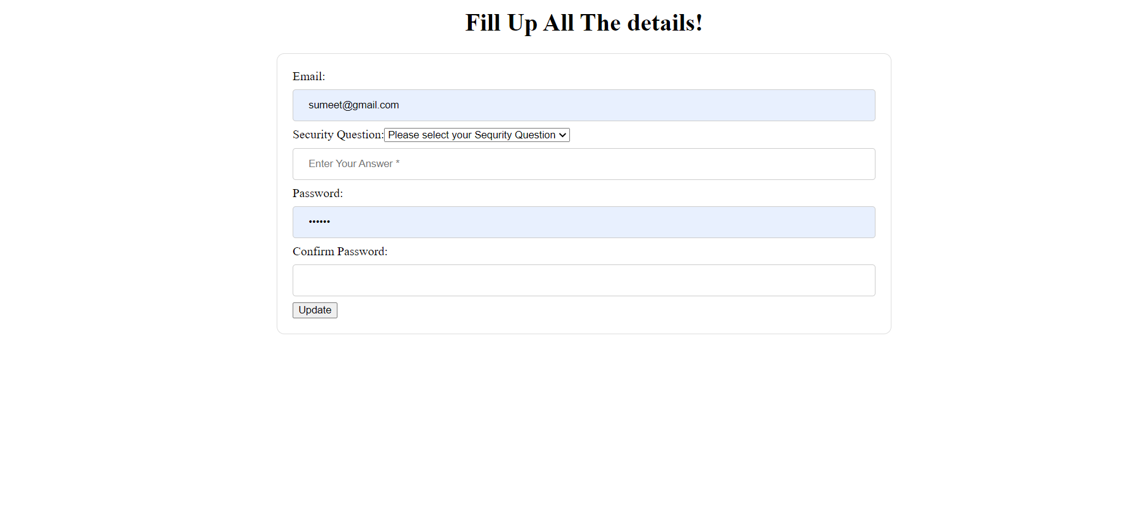
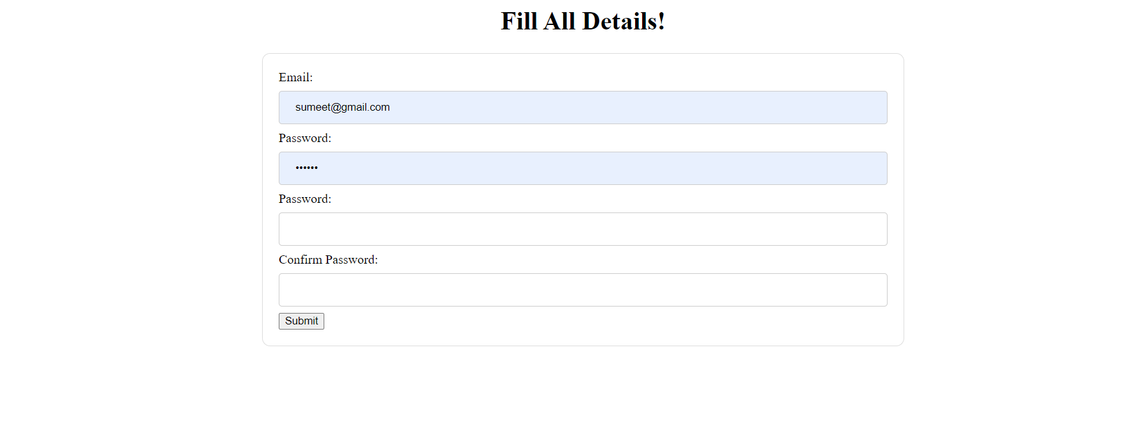
1.6 Forgot Password Page:
1.7 Change Password Page:

Slide 16
2. Admin Interface

Slide 17
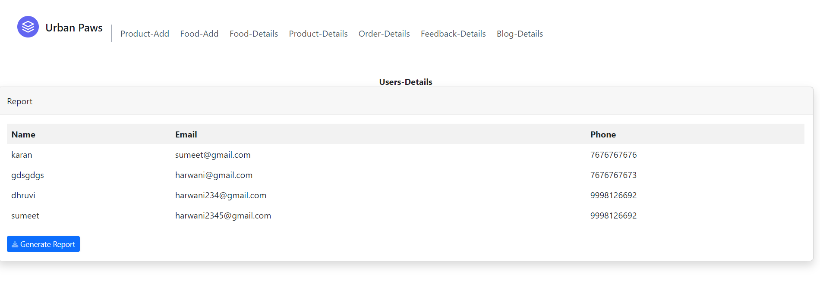
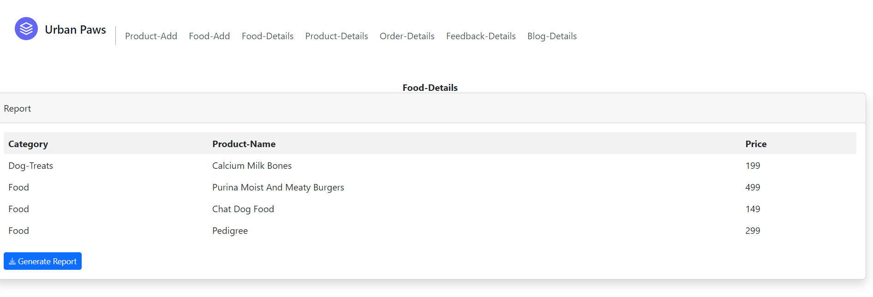
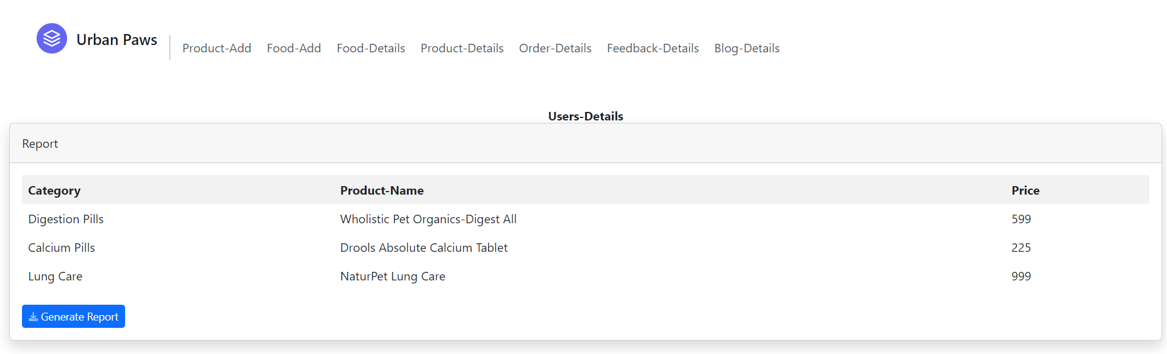
2.1 User-Details:
2.2 Food Items List
2.3 Accessories List

Slide 18
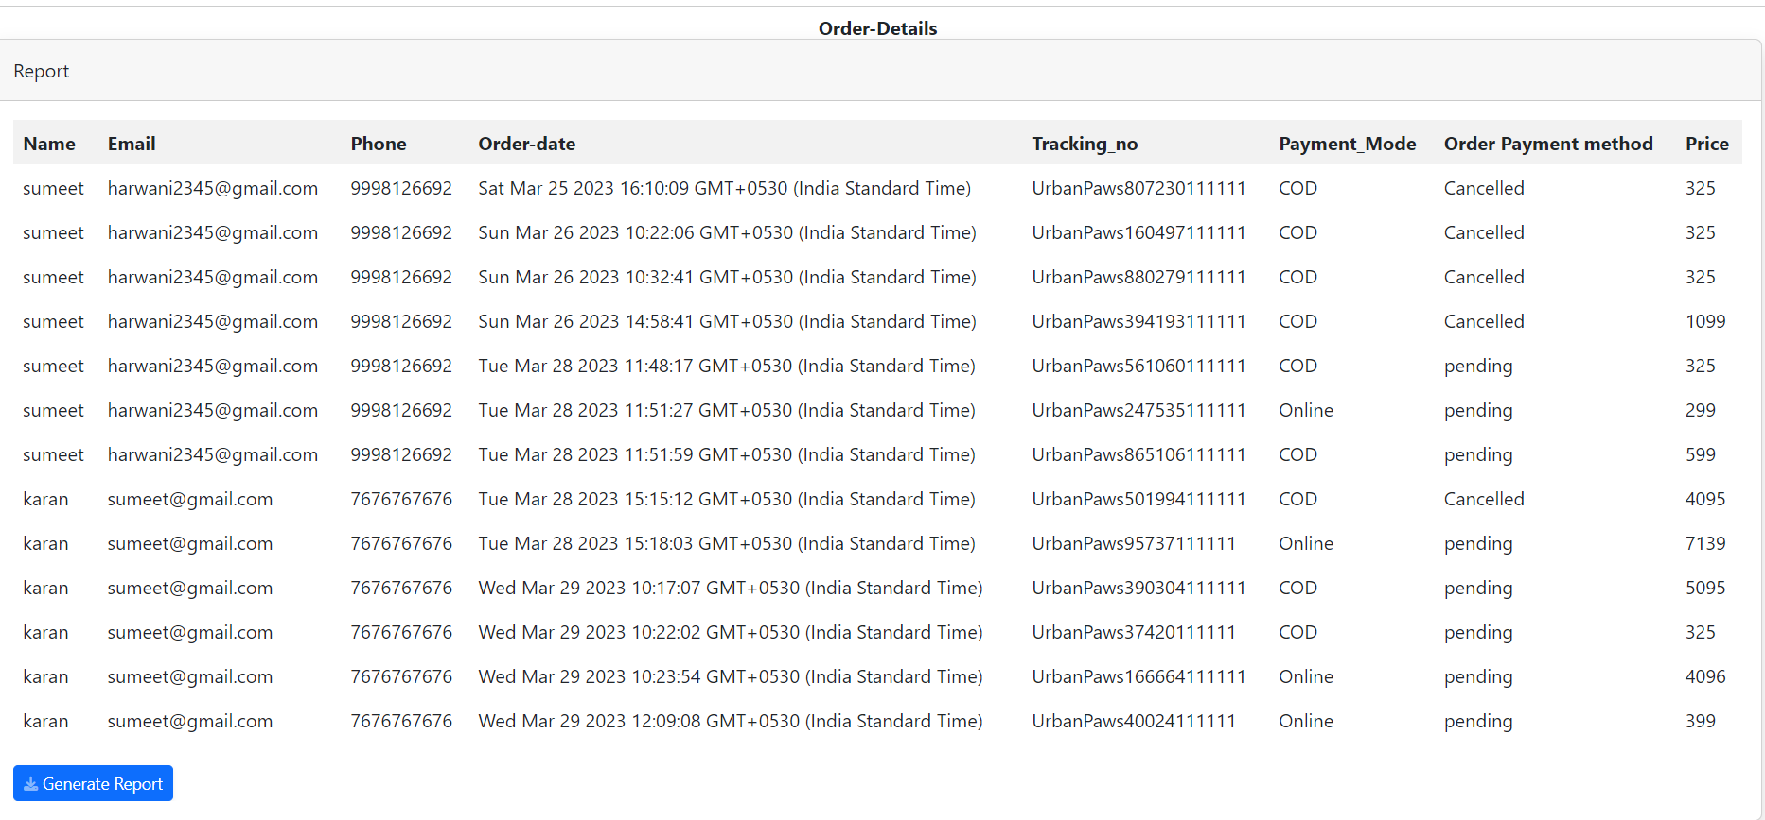
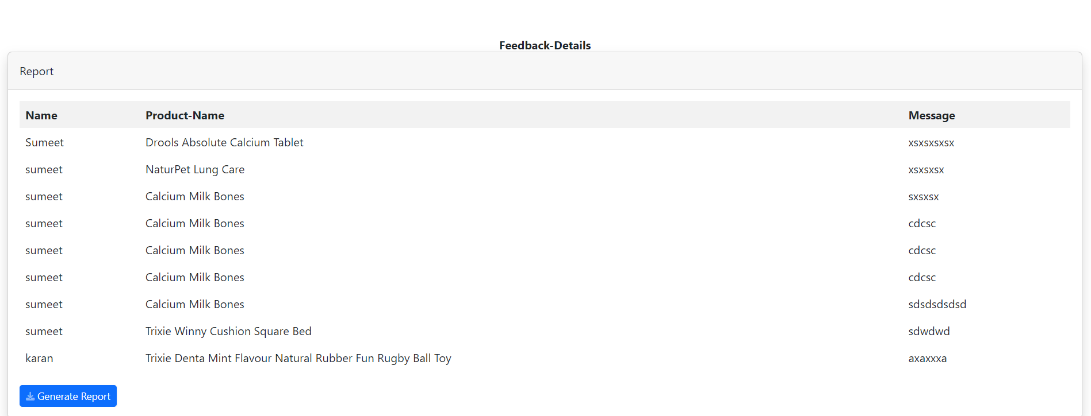
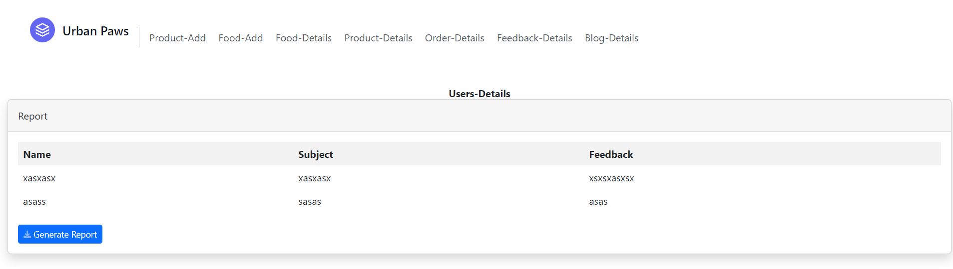
2.4 Orders List
2.5 Feedbacks List
2.6 Blog Comments

Slide 19
3. Product Upload/Delete

Slide 20
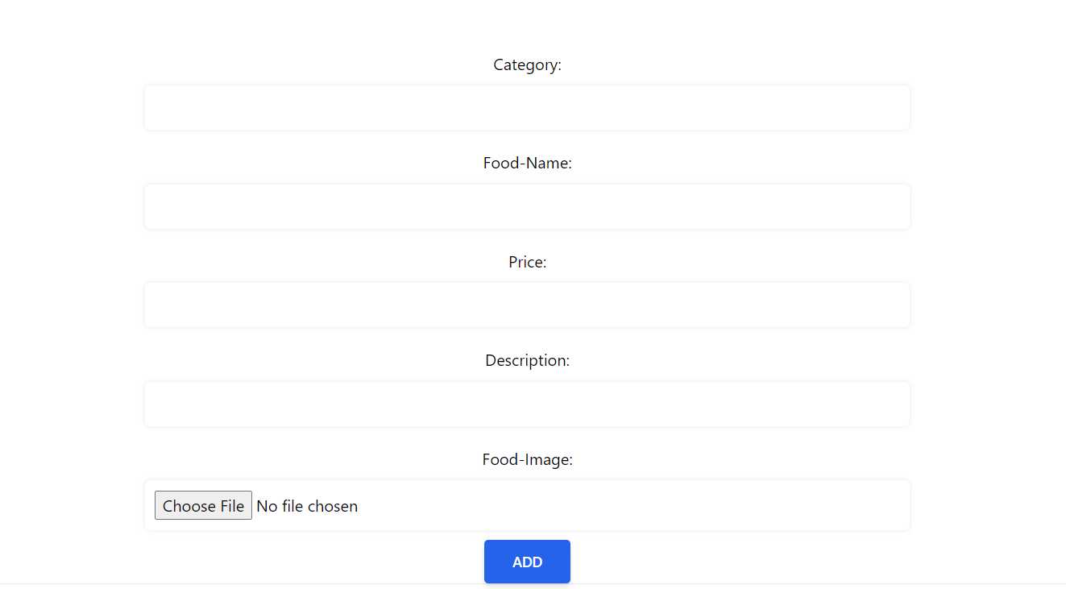
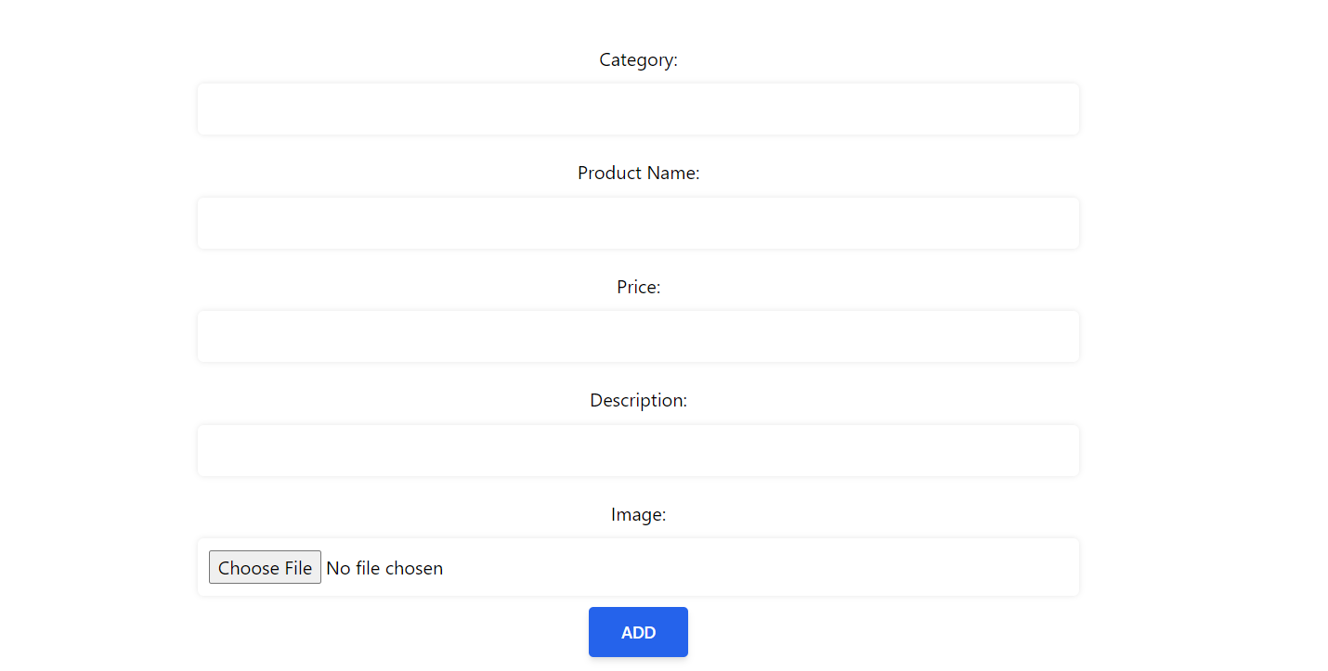
3.1 Food-Items Add
3.2 Accessories Add

Slide 21
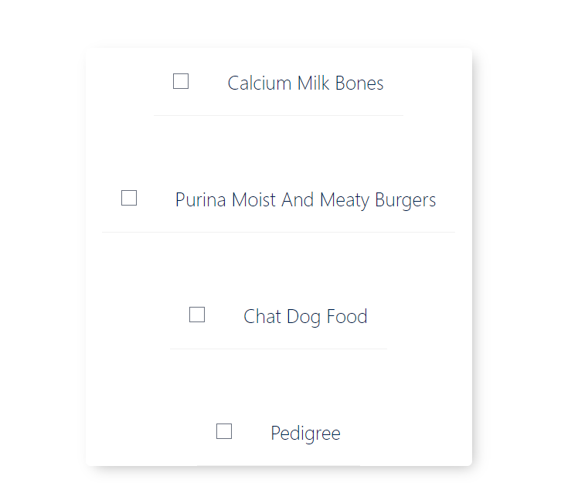
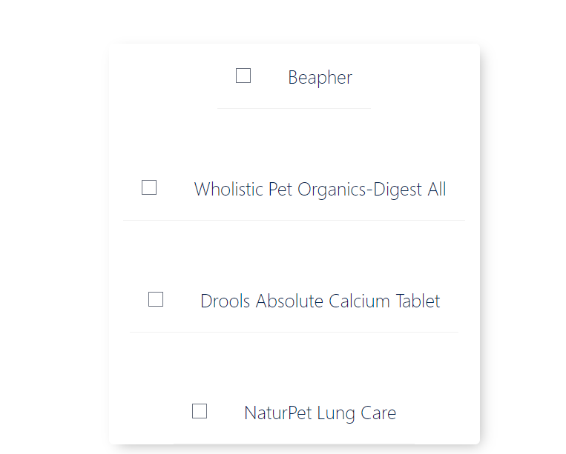
3.3 Food Items Delete
3.4 Accessories Items Delete

Slide 22
4. User Interface

Slide 23
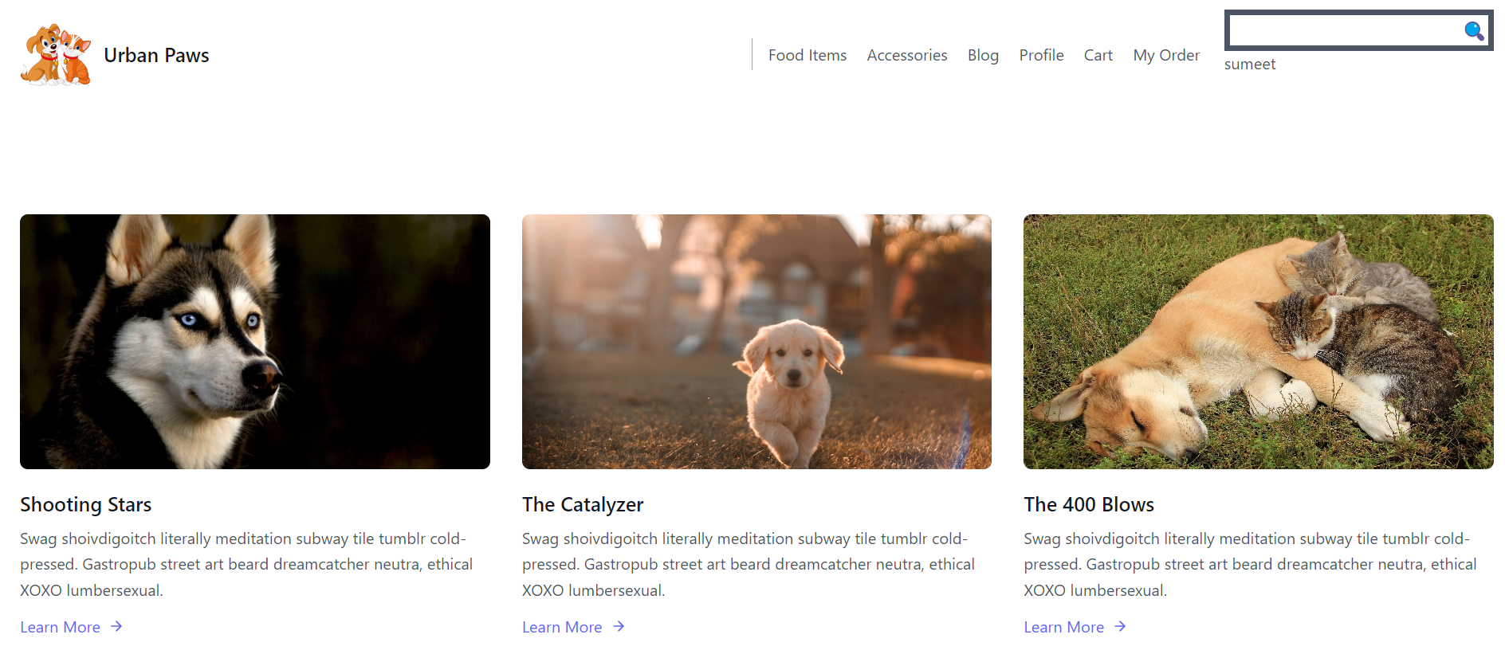
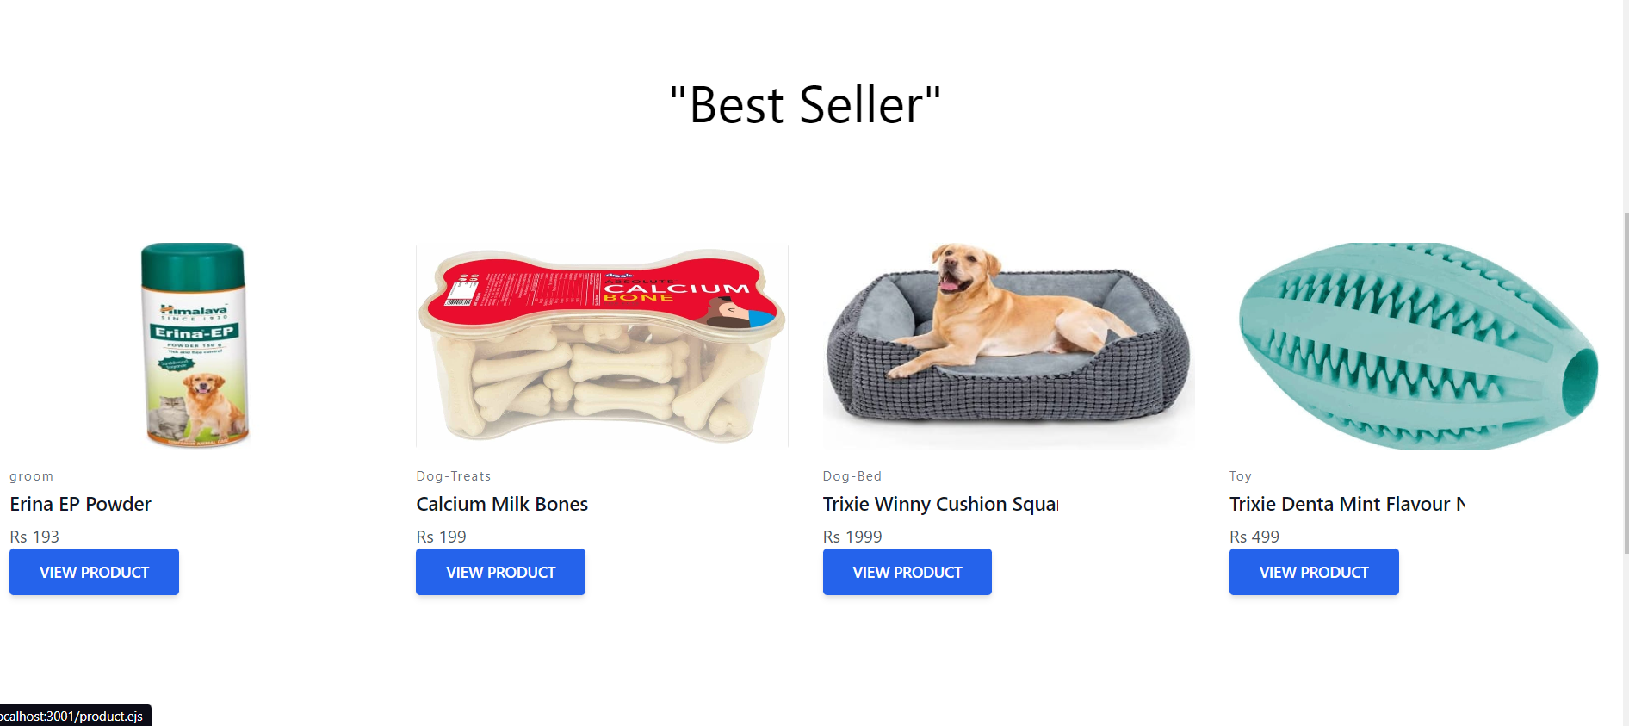
4.1 Home Page

Slide 24
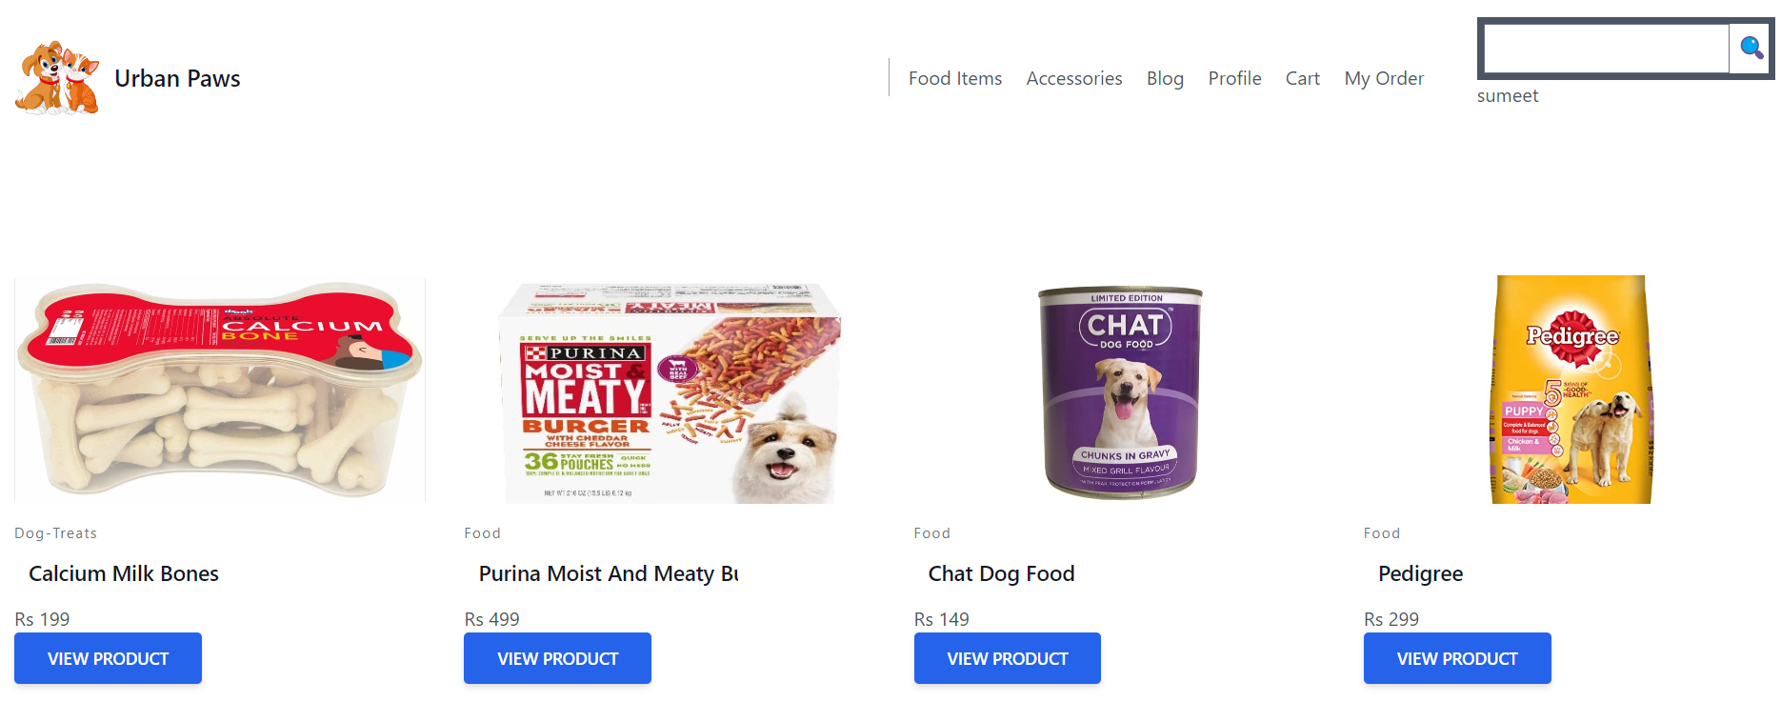
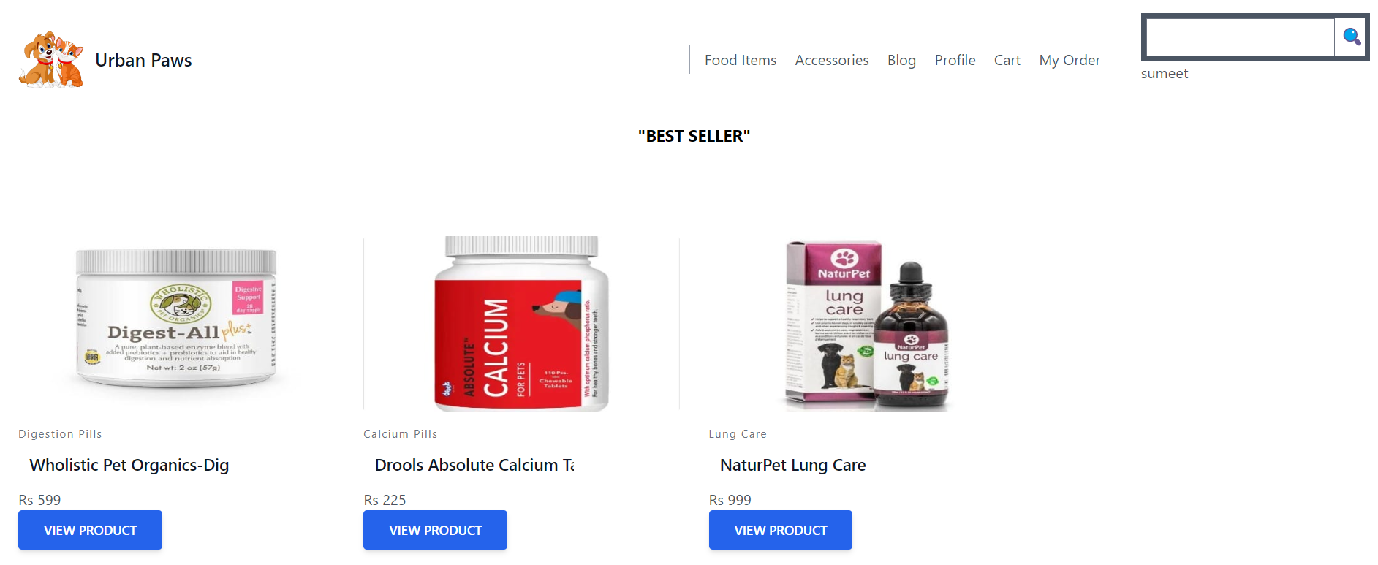
4.2 Food-Items Page
4.3 Accessories Page

Slide 25

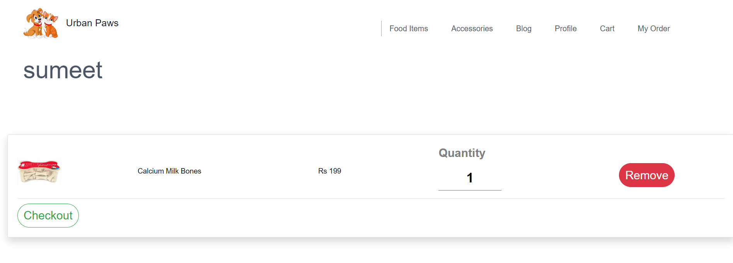
4.4 Product Page
4.5 Cart Page

Slide 26
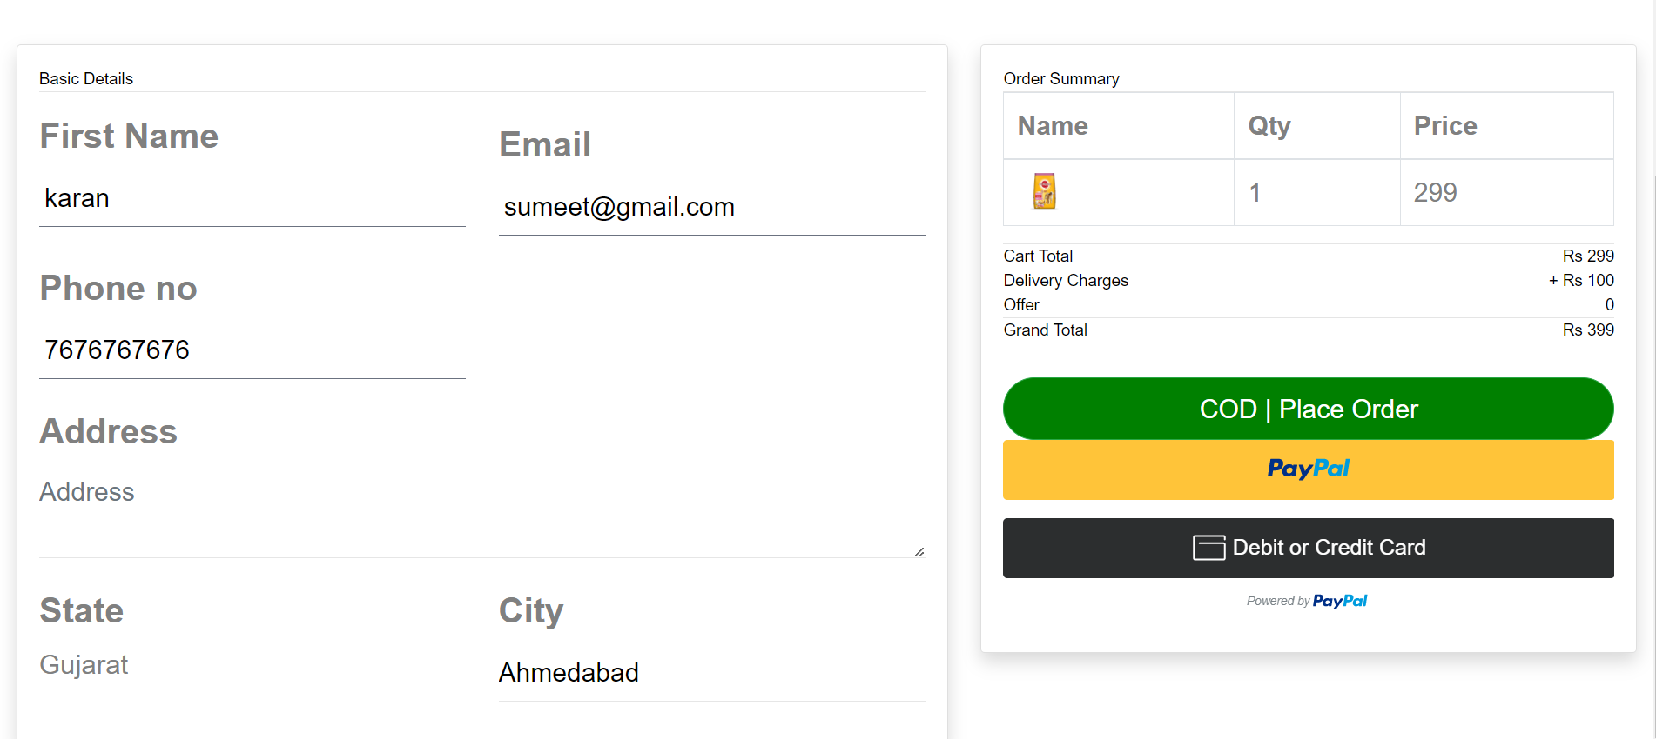
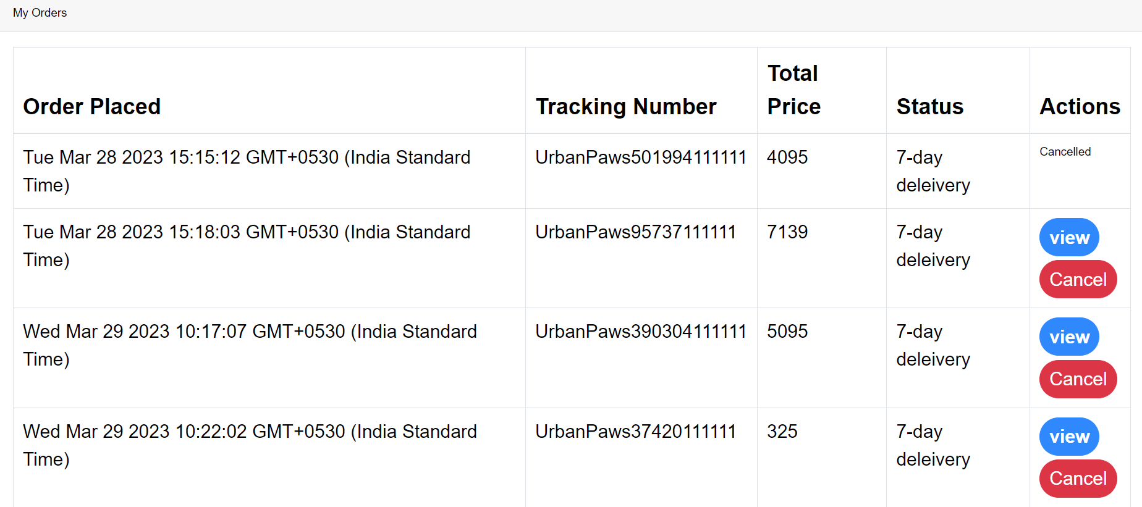
4.6 Checkout Page
4.7 MyOrder Page

Slide 27
5. Reports

Slide 28



5.1 User-Details PDF
5.2 Food-Details PDF
5.3 Accessories-Details PDF

Slide 29
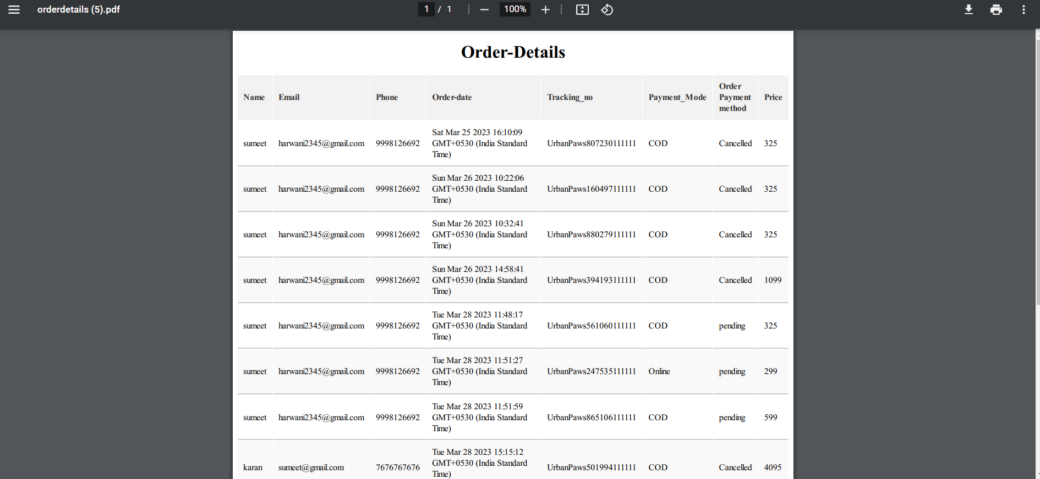


5.4 Order-Details PDF
5.5 Feedback-Details PDF
5.6 Blog Comments PDF

Slide 30
6.Conclusion
In this project, we set out to design and construct a front-end and back-end system. In this endeavour we were successful, and the resulting system has been described in these pages.
This system certainly has limitations, and requires development in
certain directions. Some of the limitations are of a fundamental
nature, and may not be removable within the present work.
Nevertheless, It would appear that the system, with a little further development, could form the basis of the sort of evaluation project originally envisaged for the Urban Paws .

Slide 31
7.Bibliography
HTML, CSS, AND JAVASCRIPT
www.w3schools.com
www.geekforgeeks.com
www.stackoverflow.com
DEVELOPING IDE
Express
BACKEND LANGUAGE & FRAMWORK
NodeJS
DATABASE
MongoDB
OUTPUT BROWSER
ANY INTERNET BROWSER

Slide 32
8.Log Sheets

